Slide 1
Computer Organization & Design 实验与课程设计
Computer Organization & Design
实验十一
Multicycle CPU design-controller
施青松
Asso. Prof. Shi Qingsong
College of Computer Science and Technology, Zhejiang University
zjsqs@zju.edu.cn

Slide 2
Course Outline
Environment
Task
Principles
Implementation
Notes:
Rudimentary logic functions=基本的逻辑函数

Slide 3
Task
1. Design controller for 9⁺ instructions
Use HDL to implement controller
Implemented based on Exp10
2. Make a test plan for controller：
OP decoding test：R-format、memory access intruction、branch instruction，jump instruction
ALU control test：Function decoding test
3. Design controller test code

Slide 4
Course Outline
Environment
Task
Principal
Implementation

Slide 5
CPU organization
Digital circuit
General circuits that controls logical event with logical gates --Hardware
Computer organization
Special circuits that processes logical action with instructions -Software
Data input
Control unit
Control signals
Datapath
Data output
Status input
Status signals
Control output

Slide 6
Multicycle datapath：9-23⁺ instructions
找出指令的通路：5+1个MUX
比单周期增加了什么通道？

Slide 7
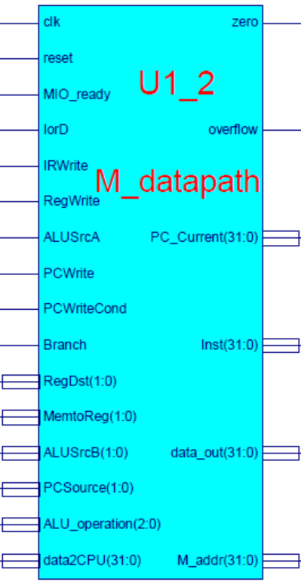
Datapath module： M_datapath
datapath
Main unit of CPU
Register transfer object：general datapath
Basic function
ALU with computing function
General purpose registers
All possible paths with counting function
Key signals
Inst_R：Instruction register output
PC_Current：current PC(PC+4)
M_addr：memory address
Branch：=1→beq；=0 → bne
PCWriteCond：for Branch instruction

Slide 8
Interface file- M_datapath.v
module M_datapath(input clk,
input reset,
input MIO_ready, //外部输入=1
input IorD,
input IRWrite,
input[1:0] RegDst, //预留到2位
input RegWrite,
input[1:0]MemtoReg, //预留到2位
input ALUSrcA,
input[1:0]ALUSrcB,
input[1:0]PCSource, //4选1控制
input PCWrite,
input PCWriteCond,
input Branch,
input[2:0]ALU_operation,
output[31:0]PC_Current,
input[31:0]data2CPU,
output[31:0]Inst,
output[31:0]data_out,
output[31:0]M_addr,
output zero,
output overflow
);
endmodule

Slide 9
Controller design
Multiple ways for controller implementation
State transition ：
State table→state function→input function→HDL description
Or state table→ HDL behavior description
excitation function and output signal：
HDL description
ROM/ PLA (text CD)
MUX
Gate circuit
In this lab, based on general design analysis of sequential circuit
Choose one method to implement。suggest：
It is not complicated for 9+ instructions，better use excitation function with HDL description to implement
Use HDL to describe state table for more instructions

Slide 10
Controller and control object

Slide 11
FSM for 9⁺ instructions asking the students to complete the corresponding state truth table
Design finite state machine

Slide 12
State encode and assignment
4 bits representation are required for 10 states
We use 4 flip flops to store state variable
State encoding is not unique, we use the one consistent to the text, but it is not the best one.
状态 | 触发器状态分配 Q_{3n} Q_{2n} Q_{1n} Q_{0n} | 备注
0 | 0 0 0 0
1 | 0 0 0 1
2 | 0 0 1 0
3 | 0 0 1 1
4 | 0 1 0 0
5 | 0 1 0 1
6 | 0 1 1 0
7 | 0 1 1 1
8 | 1 0 0 0
9 | 1 0 0 1

Slide 13
State table/next state table
Write down state table based on FSM and input variable OP₀~OP₅
16 states with 4 variables，1010~1111 are 6 non-working states
There are 6 variables for OP，2⁶=64 values，only 5 values are legal inputs, others can be taken as don’t-care。
序号 | 现 态 | 输 入(指令操作码) | 次 态 |  | 备注
 | Q_{3n} Q_{2n} Q_{1n} Q_{0n} | Op5 Op4 Op3 Op2 Op1 Op0 | Q_{3n+1} Q_{2n+1} Q_{1n+1} Q_{0n+1}
0 | 0 0 0 0 | x x x x x x | 0 0 0 1 | 1 | Op无关
1 | 0 0 0 1 | 0 0 0 0 0 0 | 0 1 1 0 | 6 | R-type
 |  | 1 0 x 0 1 1 | 0 0 1 0 | 2 | L/S
 |  | 0 0 0 1 0 0 | 1 0 0 0 | 8 | Beq
 |  | 0 0 0 0 1 0 | 1 0 0 1 | 9 | Jump
2 | 0 0 1 0 | 1 0 0 0 1 1 | 0 0 1 1 | 3 | Load
 |  | 1 0 1 0 1 1 | 0 1 0 1 | 5 | Store
3 | 0 0 1 1 | 1 0 0 0 1 1 | 0 1 0 0 | 4 | Load
4 | 0 1 0 0 | 1 0 0 0 1 1 | 0 0 0 0 | 0 | Load
5 | 0 1 0 1 | 1 0 1 0 1 1 | 0 0 0 0 | 0 | Store
6 | 0 1 1 0 | 0 0 0 0 0 0 | 0 1 1 1 | 7 | R-type
7 | 0 1 1 1 | 0 0 0 0 0 0 | 0 0 0 0 | 0 | R-type
8 | 1 0 0 0 | 0 0 0 1 0 0 | 0 0 0 0 | 0 | Beq
9 | 1 0 0 1 | 0 0 0 0 1 0 | 0 0 0 0 | 0 | Jump

Slide 14
State function
Write down state functions based on state table：
Op₄ are all “0”, functions can be simplified, but not necessary.

Slide 15
Excitation function
Excitation functions are obtained based on state functions ：
State transition are finished in this step
Draw state transition logic base on the above functions
We don’t need to get solutions by hand
EDA synthesizer will do synthesization automatically

Slide 16
State excitation table
State excitation table are obtained based on state table
Similar to the state table，only difference is that output is D flip flip value
Output truthtable are in the next page
Moore state machine，output is only related to state
序号 | 现 态 | 输 入(指令操作码) | D触发器输入 | 输出 | 备注
 | Q_{3n} Q_{2n} Q_{1n} Q_{0n} | Op5 Op4 Op3 Op2 Op1 Op0 | D₃ D₂ D₁ D₀ | 另列
0 | 0 0 0 0 | x x x x x x | 0 0 0 1 |  | Op无关
1 | 0 0 0 1 | 0 0 0 0 0 0 | 0 1 1 0 |  | R-type
 |  | 1 0 x 0 1 1 | 0 0 1 0 |  | L/S
 |  | 0 0 0 1 0 0 | 1 0 0 0 |  | Beq
 |  | 0 0 0 0 1 0 | 1 0 0 1 |  | Jump
2 | 0 0 1 0 | 0 0 0 1 1 | 0 0 1 1 |  | Load
 |  | 1 0 1 0 1 1 | 0 1 0 1 |  | Store
3 | 0 0 1 1 | 1 0 0 0 1 1 | 0 1 0 0 |  | Load
4 | 0 1 0 0 | 1 0 0 0 1 1 | 0 0 0 0 |  | Load
5 | 0 1 0 1 | 1 0 1 0 1 1 | 0 0 0 0 |  | Store
6 | 0 1 1 0 | 0 0 0 0 0 0 | 0 1 1 1 |  | R-type
7 | 0 1 1 1 | 0 0 0 0 0 0 | 0 0 0 0 |  | R-type
8 | 1 0 0 0 | 0 0 0 1 0 0 | 0 0 0 0 |  | Beq
9 | 1 0 0 1 | 0 0 0 0 1 0 | 0 0 0 0 |  | Jump

Slide 17
Output truth table
输入Q_{3n} Q_{2n} Q_{1n} Q_{0n}（当前状态—现态） |  |  |  |  |  |  |  |  |  | 输出控制信号
0000 IF | 0001 ID | 0010 MEN-Ex | 0011 MEN-RD | 0100 LW_WB | 0101 MEM_W | 0110 R_Exc | 0111 R_WB | 1000 Beq_Exc | 1001 J
1 | 0 | 0 | 0 | 0 | 0 | 0 | 0 | 0 | 1 | PCWrite
0 | 0 | 0 | 0 | 0 | 0 | 0 | 0 | 1 | 0 | PCWriteCond
0 | 0 | 0 | 1 | 0 | 1 | 0 | 0 | 0 | 0 | IorD
1 | 0 | 0 | 1 | 0 | 0 | 0 | 0 | 0 | 0 | MemRead
0 | 0 | 0 | 0 | 0 | 1 | 0 | 0 | 0 | 0 | MemWrite
1 | 0 | 0 | 0 | 0 | 0 | 0 | 0 | 0 | 0 | IRWrite
0 | 0 | 0 | 0 | 1 | 0 | 0 | 0 | 0 | 0 | MemtoReg
0 | 0 | 0 | 0 | 0 | 0 | 0 | 0 | 0 | 1 | PCSource1
0 | 0 | 0 | 0 | 0 | 0 | 0 | 0 | 1 | 0 | PCSource0
0 | 0 | 0 | 0 | 0 | 0 | 1 | 0 | 0 | 0 | ALUOp1
0 | 0 | 0 | 0 | 0 | 0 | 0 | 0 | 1 | 0 | ALUOp0
0 | 1 | 1 | 0 | 0 | 0 | 0 | 0 | 0 | 0 | ALUSrcB1
1 | 1 | 0 | 0 | 0 | 0 | 0 | 0 | 0 | 0 | ALUSrcB0
0 | 0 | 1 | 0 | 0 | 0 | 1 | 0 | 1 | 0 | ALUSrcA
0 | 0 | 0 | 0 | 1 | 0 | 0 | 1 | 0 | 0 | RegWrite
0 | 0 | 0 | 0 | 0 | 0 | 0 | 1 | 0 | 0 | RegDst

Slide 18
Controller signals：Defined 10+6+？control
实验十定义的数据通路控制信号
信号 | 源数目 | 功能定义 | 赋值0时动作 | 赋值1时动作
ALUScrA ALUSrc_B | ？ | ALU端口A、B输入选择
RegDst | ？ | 寄存器写地址选择(考虑扩展)
MemtoReg | ？ | 寄存器写数据选择(考虑扩展)
IorD | ？ | 新增
PCSource | ？ | 新增
PCWriteCond | ？ | 新增
…… | ？ | 新增
Branch | ？ | Beq指示(考虑Bne扩展)
RegWrite | - | 寄存器写控制
MemWrite | - | 存储器写控制
MemRead | - | 存储器读控制
ALU_Control | 000- 111 | 3位ALU操作控制 | 参考表 Exp04 | Exp04
请填写信号赋值时
对应操作

Slide 19
Fill in the following truth table, which is compatible with datapath of Exp10
状态 输出信号 | 0000 | 0001 | 0010 | 0011 | 0100 | 0101 | 0110 | 0111 | 1000 | 1001
 | IF | ID | MEM-Ex | MEM-RD | LW_WB | MEM_W | R_Exc | R_WB | Beq_Exc | J
PCWrite | 1 | 0 | 0 | 0 | 0 | 0 | 0 | 0 | 0 | 1
PCWriteCond | 0 | 0 | 0 | 0 | 0 | 0 | 0 | 0 | 1 | 0
IorD | 0 | 0 | 0 | 1 | 0 | 1 | 0 | 0 | 0 | 0
MemRead | 1 | 0 | 0 | 1 | 0 | 0 | 0 | 0 | 0 | 0
MemWrite | 0 | 0 | 0 | 0 | 0 | 1 | 0 | 0 | 0 | 0
IRWrite | 1 | 0 | 0 | 0 | 0 | 0 | 0 | 0 | 0 | 0
MemtoReg | 00 | 00 | 00 | 00 | 01 | 00 | 00 | 00 | 00 | 00
PCSource1 | 0 | 0 | 0 | 0 | 0 | 0 | 0 | 0 | 0 | 1
PCSource0 | 0 | 0 | 0 | 0 | 0 | 0 | 0 | 0 | 1 | 0
ALUSrcA | 0 | 0 | 1 | 0 | 0 | 0 | 1 | 0 | 1 | 0
ALUSrcB1 | 0 | 1 | 1 | 0 | 0 | 0 | 0 | 0 | 0 | 0
ALUSrcB0 | 1 | 1 | 0 | 0 | 0 | 0 | 0 | 0 | 0 | 0
RegWrite | 0 | 0 | 0 | 0 | 1 | 0 | 0 | 1 | 0 | 0
RegDst | 00 | 00 | 00 | 00 | 00 | 00 | 00 | 01 | 00 | 00
Branch | 0 | 0 | 0 | 0 | 0 | 0 | 0 | 0 | 1 | 0
ALUOp1 | 0 | 0 | 0 | 0 | 0 | 0 | 1 | 0 | 0 | 0
ALUOp0 | 0 | 0 | 0 | 0 | 0 | 0 | 0 | 0 | 1 | 0
MEM_IO | 0 | 0 | 0 | 1 | 0 | 1 | 0 | 0 | 0 | 0
Fill in the blanks

Slide 20
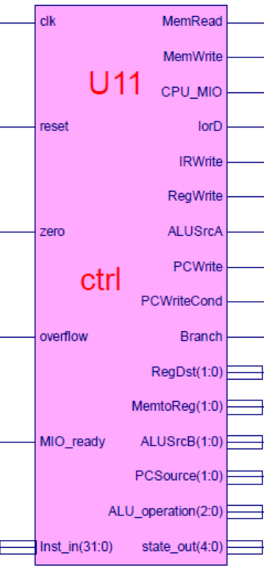
CPU unit two-controller：ctrl
controller
CPU main unit
Control register transfer：
Transform state to instructions based on FSM
Basic function
Microoperation control
Data transfer control
Key signals
MIO_ready：外设就绪
=0 CPU等待
=1 CPU正常运行
本实验恒等于1
Inst_in：指令输入，来自IR输出
State_out：状态编码，用于测试

Slide 21
Interface file- ctrl.v
module ctrl(input clk,
input reset,
input [31:0] Inst_in,
input zero,
input overflow,
input MIO_ready, //外部输入=1
output reg MemRead,
output reg MemWrite,
output reg[2:0]ALU_operation, //ALU_Control
output [4:0]state_out,
output reg CPU_MIO,
output reg IorD,
output reg IRWrite,
output reg [1:0]RegDst, //预留到2位
output reg RegWrite,
output reg [1:0]MemtoReg, //预留到2位
output reg ALUSrcA,
output reg [1:0]ALUSrcB,
output reg [1:0]PCSource,
output reg PCWrite,
output reg PCWriteCond,
output reg Branch
);
endmodule

Slide 22
Controller implementation
Controller implementation
Same as single-cycle implementation for 9⁺instructions, use two-level decoder
Main controller generate ALUop
ALU decoder use the one of single-cycle implementation
FSM implementation
FSM implementation, please refer to 3 ways described in digital logic
State transition implementation, choose from the following：
State function/excitation function：
HDL description based on state table：
Excitation function and output signals：
HDL description：convenient for project design
SOP gate circuit
ROM
MUX
Choose any way to implement FSM
Good for understanding theory part

Slide 23
U3-memory initialization data reference：mem.coe contains both code and data
memory_initialization_radix=16;
memory_initialization_vector=
00A52820, AC650000, 8C650000, 00A85824, 01A26820, 11A00017, 8C650000, 01CE9020, 0252B020, 02569020, 00B25824, 11600005, 1172000A, 01CE9020, 1172000B, AC890000, 08000036, 11410001, 0800004D, 00005027, 014A5020, AC8A0000, 08000036, 8E290860, AC890000, 08000036, 8E290820, AC890000, 08000036, 8C0D0014, 014A5020, 01425025, 022E8820, 02348824, 01224820, 11210001, 0800005F, 000E4820, 01224820, 8C650000,
00A55820, 016B5820, AC6B0000, AC660004, 0800003E, 00000000, 00000000, 00000000, 00000000, 00000000, 00000000, 00000000, 00000000, 00000000, 00000000, 00000000, 00000000, 00000000, 00000000, 00000000, 00000000, 00000000, 00000000, 00000000, 00000000, 00000000, 00000000, 00000000, 00000000, 00000000, 00000000, 00000000， ………………
………………
F0000000, 000002AB, 80000000, 0000003F, 00000001, FFFF0000, 0000FFFF, 80000000, 00000000, 11111111, 22222222, 33333333, 44444444, 55555555, 66666666, 77777777, 88888888, 99999999, AAAAAAAA, BBBBBBBB, CCCCCCCC, DDDDDDDD, EEEEEEEE, FFFFFFFF, 557EF7E0, D7BDFBD9, D7DBFDB9, DFCFFCFB, DFCFBFFF, F7F3DFFF, FFFFDF3D, FFFF9DB9, FFFFBCFB, DFCFFCFB, DFCFBFFF, D7DB9FFF, D7DBFDB9, D7BDFBD9, FFFF07E0, 007E0FFF,
03BDF020, 03DEF820, 08002300, 00000000, 00000000, 00000000, 00000000, 00000000;
For 9 instructions，modified based on lab3
Code section：地址从00000000开始
Data section：地址起始需要约定：此代码为00000200

Slide 24
Course Outline
Environment
Task
Principles
Implementation
Notes:
Rudimentary logic functions=基本的逻辑函数

Slide 25
Multicycle CPU controller design
-to control datapath designed in lab10

Slide 26
project：OExp11-OwnMCPU
Design multicycle CPU controller
Design state diagram and state table
Complete controller circuit based on state table, use HDL description
Must use state table structural description, or excitation function description (cannot use behavior description)
Simulation for controller module
Substitute controller module
Substitute ctrl.ngc core of Exp10
Top module of Exp10 can still be used：Top_OExp10_OwnMCPU.v
Controller test
Design test program(MIPS assembling program) to test：
OP decoding test：
R-format、memory access instructions、branch instructions，jump instruction
Arithmetic operation control test：Function decoding

Slide 27
Gist
Design main controller
Complete output truth table
Use HDL to describe state transition and output control signals
Or use excitation function to implement state function and output control signals
Design ALU op decoder
Separate ALU decoder of single cycle and make a modification
Use DEMO for function test
ALU must contain “nor”operation
Otherwise you need to modify or redesign a test program
Simulation for controller
Can do simulation separately or combined,
Finally, all parts are combined into one controller module.

Slide 28
Multicycle controller design
Use excitation function description to implement

Slide 29
HDL description for excitation functions
Main controller description
parameter IF = 4'b0000, ……
parameter AND=3'b000, OR=3'b001, ADD=3'b010, SUB=3'b110, ……
`define Datapath_signals {PCWrite, PCWriteCond, …… }
always @ (posedge clk or posedge reset)
if (reset==1) Q <= IF;
else Q <= D;
输出变量(信号)描述
ALU操作译码描述
状态转换
激励方程描述
数据通路控制
ALU操作控制

Slide 30
Use excitation function to implement FSM
parameters
State variables
parameter IF = 4'b0000, ID = 4'b0001, Mem_Ex = 4'b0010, Mem_RD = 4'b0011, LW_WB = 4'b0100, Mem_W = 4'b0101, R_Exc = 4'b0110, R_WB = 4'b0111, Beq_Exc= 4'b1000, J= 4'b1001, Error = 4'b1111;
Output variables
`define Datapath_signals {PCWrite, PCWriteCond,IorD, MemRead, MemWrite,IRWrite, MemtoReg, PCSource, ALUSrcA, ALUSrcB, RegWrite, RegDst, Branch, ALUop, CPU_MIO}
Output values：根据输出信号真值表
parameter value0 = 20'b10010100000010000000, value1 = 20'b00000000000110000000,
value2 = 20'b00000000001100000000, value3 = 20'b00110000000000000001,
value4 = 20'b00000001000001000000, value5 = 20'b00101000000000000001,
value6 = 20'b00000000001000000100, value7 = 20'b00000000000001010000,
value8 = 20'b01000000011000001010, value9 = 20'b10000000100000000000;
parameter AND=3'b000, OR=3'b001, ADD=3'b010, SUB=3'b110, NOR=3'b100, SLT=3'b111, XOR=3'b011, SRL=3'b101;

Slide 31
Excitation function description
Use assign statement based on D Flip flop input function
Can also use schematic description
本参考采用状态变量和操作码分别描述然后组合
状态译码描述
assign s0 = ~|Q; //if Q=0000 then s0 = 1
assign s1 = ~Q[3] && ~Q[2] && ~Q[1] && Q[0] ; //if Q=0001 then s1 = 1
assign s2 = ~Q[3] && ~Q[2] && Q[1] && ~Q[0] ; //if Q=0010 then s2 = 1
assign s3 = ~Q[3] && ~Q[2] && Q[1] && Q[0] ; //if Q=0011 then s3 = 1
assign s4 = ~Q[3] && Q[2] && ~Q[1] && ~Q[0] ; //if Q=0100 then s4 = 1
assign s5 = ~Q[3] && Q[2] && ~Q[1] && Q[0] ; //if Q=0101 then s5 = 1
assign s6 = ~Q[3] && Q[2] && Q[1] && ~Q[0] ; //if Q=0110 then s6 = 1
assign s7 = ~Q[3] && Q[2] && Q[1] && Q[0] ; //if Q=0111 then s7 = 1
assign s8 = Q[3] && ~Q[2] && ~Q[1] && ~Q[0] ; //if Q=1000 then s8 = 1
assign s9 = Q[3] && ~Q[2] && ~Q[1] && Q[0] ; //if Q=1001 then s9 = 1
请完成后继部分

Slide 32
操作码译码描述
assign Rtype = ~|OP; //if OP=000000 then Rtype = 1
assign LS = (OP == 6'b10x011) ? 1 : 0; //if OP=10x011 then LS = 1
assign IBeq = (OP == 6'b000100) ? 1 : 0; //if OP=000100 then Ibeq = 1
assign Jump = (OP == 6'b000010) ? 1 : 0; //if OP=000010 then Jump = 1
assign Load = (OP == 6'b100011) ? 1 : 0; //if OP=100011 then Load = 1
assign Store = (OP == 6'b101011) ? 1 : 0; //if OP=101011 then Store = 1
激励方程合成描述
assign D[3] = s1 && (IBeq || Jump);
assign D[2] = s1 && Rtype || s2 && Store || s3 && Load || s6 && Rtype;
assign D[1] = s1 && (LS || Rtype) || s2 && Load || s6 && Rtype;
assign D[0] = s0 || s1 && Jump || s2 && Load || s2 && Store || s6 && Rtype;
状态转换描述
always @ (posedge clk or posedge reset)
if (reset==1) Q <= IF;
else Q <= D;
请完成后继部分

Slide 33
输出变量(信号)描述
always @ * begin
case(Q) //state
IF: `Datapath_signals = value0;
ID: `Datapath_signals = value1;
Mem_Ex: `Datapath_signals = value2;
Mem_RD: `Datapath_signals = value3;
LW_WB: `Datapath_signals = value4;
Mem_W: `Datapath_signals = value5;
R_Exc: `Datapath_signals = value6;
R_WB: `Datapath_signals = value7;
Beq_Exc: `Datapath_signals = value8;
J: `Datapath_signals = value9;
default: `Datapath_signals = value0;
endcase
请完成后继部分

Slide 34
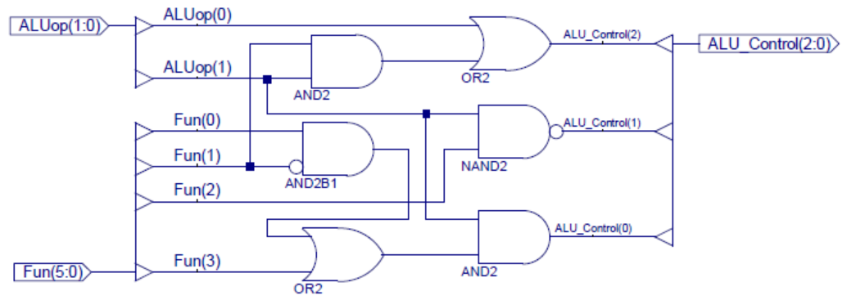
ALU operation decoder
Use two level decoder in this lab
Call decoder of single cycle implementation
Modify single cycle controller
Separate ALU decoding part (原理图2部分)
ALU_Decoder ALU_D(.ALUop(ALUop),
.Fun(Inst_in[5:0]),
.ALU_Control(ALU_operation));

Slide 35
Multicycle controller design
HDL description implementation

Slide 36
HDL description for controller
Main controller description
parameter IF = 4'b0000, ……
parameter AND=3'b000, OR=3'b001, ADD=3'b010, SUB=3'b110, ……
`define Datapath_signals {PCWrite, PCWriteCond, …… }
always @ (posedge clk or posedge reset)begin
……
end
always @* begin
……输出变量(信号)描述
end
ALU操作译码描述
状态机
数据通路控制
ALU操作控制

Slide 37
State transition description
always @ (posedge clk or posedge reset)
if (reset==1) state <= IF;
else
case (state)
IF: if(MIO_ready) state <= ID;
else state <= IF;
ID: case (Inst_in[31:26])
6'b000000: state <= R_Exc; //R-type OP
6'b100011: state <= Mem_Ex; //Lw
………………
6'b000100: state <= Beq_Exc; //Beq
default: state <= Error;
endcase
Mem_Ex:begin
…………
Error: state <= Error;
default: state <= Error;
endcase

Slide 38
输出变量(信号)描述：与激励方程时相同
always @ * begin
case(Q) //state
IF: `Datapath_signals = value0;
ID: `Datapath_signals = value1;
Mem_Ex: `Datapath_signals = value2;
Mem_RD: `Datapath_signals = value3;
LW_WB: `Datapath_signals = value4;
Mem_W: `Datapath_signals = value5;
R_Exc: `Datapath_signals = value6;
R_WB: `Datapath_signals = value7;
Beq_Exc: `Datapath_signals = value8;
J: `Datapath_signals = value9;
default: `Datapath_signals = value0;
endcase
请完成后继部分

Slide 39
ALU operation decoder
always @ * begin
case(ALUop)
2'b00: ALU_operation = 3'b010; //add计算地址
2'b01: ALU_operation = 3'b110; //sub比较条件
2'b10:
case (Inst_in[5:0])
6'b100000: ALU_operation = ADD;
6'b100010: ALU_operation = SUB;
6'b100100: ALU_operation = AND;
6'b100101: ALU_operation = OR;
6'b100111: ALU_operation = NOR;
6'b101010: ALU_operation = SLT;
6'b000010: ALU_operation = SRL; //shfit 1bit right
6'b000000: ALU_operation = XOR;
default: ALU_operation = ADD;
endcase
2'b11: ALU_operation = 3'b111; //slti
endcase
end

Slide 40
Multicycle controller implementation
Integration and substitution

Slide 41
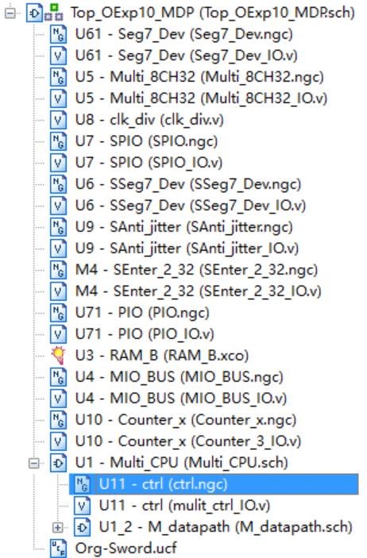
Controller integration and substitution
Integration and substitution
Replace controller IP core of Exp10 after simulation is correct
Remove controller core from project
Remove controller core connection from Exp10 project
Delete controller core files
ctrl.ngc文件
在Project菜单中运行： Cleanup Project Files …
Suggest to rebuild project use Exp10 resources
Except ctrl.ngc core
Need to be removed

Slide 42
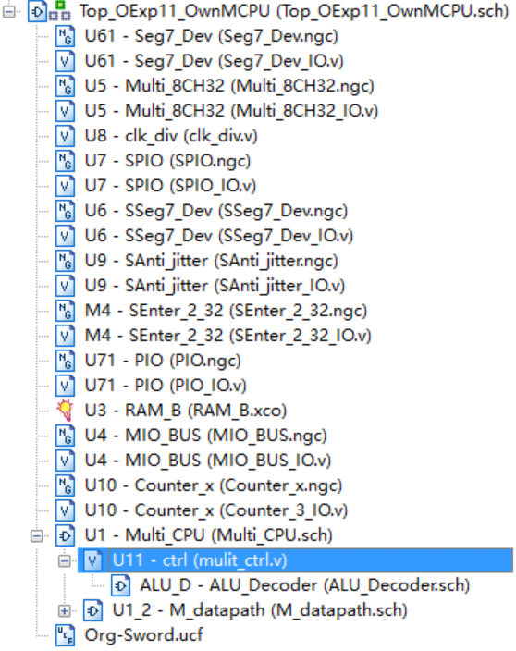
Project structure after replacing ctrl core
Module calls relationship after Exp11 datapath replacement
Control module after replacement

Slide 43
Physical verification
使用DEMO程序目测控制器功能(同实验十)
DEMO接口功能
SW[7:5]=000， SW[2]=0(全速运行)
SW[4:3]=00， SW[0]=0，点阵显示程序：跑马灯
SW[4:3]=00， SW[0]=0，点阵显示程序：矩形变幻
SW[4:3]=01， SW[0]=1，内存数据显示程序：0～F
SW[4:3]=10， SW[0]=1，当前寄存器R9+1显示
用汇编语言设计测试程序
测试ALU指令(R-格式译码、 Function译码)
测试LW/SW指令(I-格式译码)
测试分支指令(I-格式译码)
测试转移指令(J-格式译码)

Slide 44
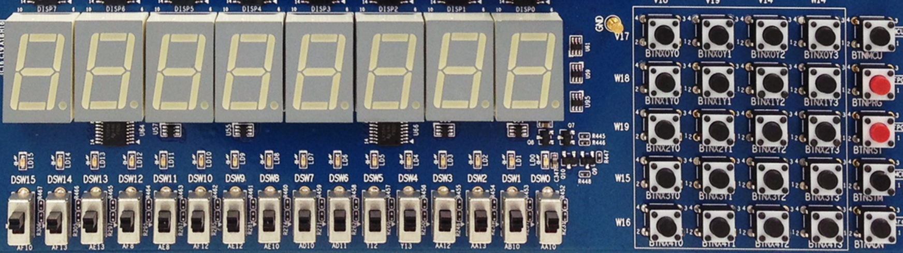
物理验证-DEMO接口功能
X₀Y₀
X₀Y₁
X₀Y₂
X₀Y₃
MCU3
0
1
2
3
X₁Y₀
X₁Y₁
X₁Y₂
X₁Y₃
PRGO
SEG3
SEG2
SEG1
SEG0
SEG3
SEG2
SEG1
SEG0
4
5
6
7
X₂Y₀
X₂Y₁
X₂Y₂
X₂Y₃
RSTN
LED15 LED14 LED13 LED12 LED11 LED10 LED9 LED8 LED7 LED6 LED5 LED4 LED3 LED2 LED1 LED0
8
9
A
B
X₃Y₀
X₃Y₁
X₃Y₂
X₃Y₃
MCU1~2
C
D
E
F
W15 SW14 SW13 SW12 SW11 SW10 SW9 SW8 SW7 SW6 SW5 SW4 SW3 SW2 SW1 SW0
X₄Y₀
X₄Y₁
X₄Y₂
X₄Y₃
Ardunio
SW[7:5]=显示通道选择
SW[7:5]=000：CPU程序运行输出
SW[7:5]=001：测试PC字地址
SW[7:5]=010：测试指令字
SW[7:5]=011：测试计数器
SW[7:5]=100：测试RAM地址
SW[7:5]=101：测试CPU数据输出
SW[7:5]=110：测试CPU数据输入
SW[0]=文本图形选择
SW[1]=高低16位选择
没有使用
SW[2]=CPU单步时钟选择
DEMO功能，测试程序可以替换成自己的功能
SW[4:3]=00，点阵显示程序：跑马灯
SW[4:3]=00，点阵显示程序：矩形变幻
SW[4:3]=01，内存数据显示程序：0～F
SW[4:3]=10，当前寄存器+1显示

Slide 45
测试程序参考：ALU指令
设计ALU指令测试程序替换DEMO程序
ALU、Regs测试参考设计，测试结果通过CPU输出信号单步观察
SW[7:5]=100, Addr_out = ALU输出
SW[7:5]=101，Data_out= 寄存器B输出
#baseAddr 0000
loop: nor r1,r0,r0; //r1=FFFFFFFF
slt r2,r0,r1; //r2=00000001
add r3,r2,r2; //r3=00000002
add r4,r3,r3; //r4=00000004
add r5,r4,r2; //r5=00000005
add r6,r5,r5; //r6=0000000A
nor r7,r5,r5; //r7=FFFFFFFA
sub r8,r7,r5; //r8=FFFFFFF5
and r9,r8,r5; //r9=00000005
and r10,r8,r6; //r10=00000000
or r11,r5,r6; //r11=0000000F
or r12,r11,r7; //r12=0000000A
slt r13,r5,r7; //r13=00000000
……
j loop;

Slide 46
测试程序参考： LW/SW
设计LW/SW程序替换DEMO程序
参考Lab5通道测试设计。测试结果通过CPU输出信号单步观察
存储器地址通过Addr_out通道4观察：14+$zero
#baseAddr 0000
start: //通道结果由后一条指令读操作数观察
lw r5, 14($zero); //取测试常数55555555。存储器读通道
start_A:
add r1, r5, $zero; //r1: 寄存器写通道。R5:寄存器读通道A输出
nor r2, $zero, r1; //r1: 寄存器读通道B输出。R2:ALU输出通道
lw r5, 48($zero); //取测试常数AAAAAAAA。立即数通道:00000048
beq r2, r5 test_sw; //循环测试
j start; //循环测试。立即数通道：00000014
test_sw: …… //增加写SW测试，如14和48单元交换
j start; //循环测试。立即数通道：00000014
测试的完备性
上述测试正确仅表明地址计算、存储单元和总线传输部分正确
要测试其完全正确，必须遍历所有可能的情况

Slide 47
动态LW/SW测试
利用七段显示设备可以设计动态测试程序
7段码显示器的地址是E0000000/FFFFFFE0
LED显示地址是F0000000/FFFFFF00
SW指令输出测试结果：sw
请设计存储器模块测试程序
测试结果在7段显示器上指示
RAM初始化数据同Exp10
00A52820, AC650000, 8C650000, 00A85824, 01A26820, 11A00017, 8C650000, 01CE9020, 0252B020, 02569020, ……
F0000000, 000002AB, 80000000, 0000003F, 00000001, FFF70000, 0000FFFF, 80000000, 00000000, 11111111, 22222222, 33333333, 44444444, 55555555, 66666666, 77777777, 88888888, 99999999, aaaaaaaa, bbbbbbbb, cccccccc, dddddddd, eeeeeeee, FFFFFFFF, 557EF7E0, D7BDFBD9, D7DBFDB9, DFCFFCFB, DFCFBFFF, F7F3DFFF, FFFFDF3D, FFFF9DB9, FFFFBCFB, DFCFFCFB, DFCFBFFF, D7DB9FFF, D7DBFDB9, D7BDFBD9, FFFF07E0, 007E0FFF, 03bdf020, 03def820, 08002300;
代码区
数据区

Slide 48
设计测试记录表格
ALU指令测试结果记录
自行设计记录表格
LW/SW指令测试结果记录
自行设计记录表格
动态存储模块测试记录
自行设计记录表格

Slide 49
思考题
用HDL直接描述状态机时同时输出控制信号需要如何修改？
设计bne指令需要增加控制信号吗？
扩展下列指令，控制器将作如何修改：
R-Type： srl*, jr, jalr, eret*；
I-Type： addi, andi, ori, xori, lui, bne, slti
J-Type： Jal；
此时用二级译码有优势吗？
状态机调试你有什么建议？

Slide 50
END

